Slide 1
ER-3
13.3

Slide 2
Participation constraints in DBMS
Total
Partial

Slide 3
Participation constraints
It specifies whether the existence of an entity depends on its being related to another entity via a relationship set. These constraints specify the minimum and maximum number of relationship instance that each entity can or must participate in.
Max Cardinality: It defines the maximum number of times an entity occurrence participating in a relationship.
Min Cardinality: It defines the minimum number of times or entity occurrence participating in a relationship.

Slide 4
Participation constraints
Language Course
R
Student
LC1
LC2
LC3
..
LCn
S1
S2
S3
..
Sn

Slide 5
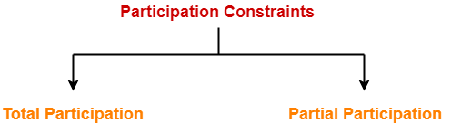
Participation constraints
There are two ways by which an entity can participate in a relationship:

Slide 6
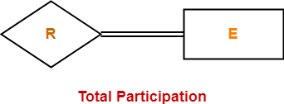
Total Participation (TP)
It specifies that each entity in the entity set must compulsorily participate in at least one relationship instance in that relationship set. That is why, it is also called as mandatory participation. Total participation is represented using a double line between the entity set and relationship set.

Slide 7

Example
Here, Double line between the entity set “Student” and relationship set “Enrolled in” signifies total participation.
It specifies that each student must be enrolled in at least one course.

Slide 8
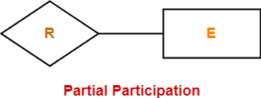
Partial Participation (PP)
It specifies that each entity in the entity set may or may not participate in the relationship instance in that relationship set.
That is why, it is also called as optional participation.
Partial participation is represented using a single line between the entity set and relationship set.

Slide 9
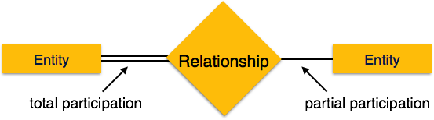
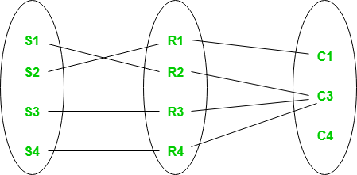
Example
Here,
Single line between the entity set “Course” and relationship set “Enrolled in” signifies partial participation.
It specifies that there might exist some courses for which no enrollments are made.
Every student in Student Entity set is participating in relationship but there exists a course C4 which is not taking part in the relationship.
Relationship between Cardinality and Participation Constraints-
Minimum cardinality tells whether the participation is partial or total.
If minimum cardinality = 0, then it signifies partial participation.
If minimum cardinality = 1, then it signifies total participation.
Maximum cardinality tells the maximum number of entities that participates in a relationship set.

Slide 10


